Slide 1
Creative Writing School
Here is where your presentation begins

Slide 2
Contents of this template
You can delete this slide when you’re done editing the presentation
Fonts | To view this template correctly in PowerPoint, download and install the fonts we used
Used and alternative resources | An assortment of graphic resources that are suitable for use in this presentation
Thanks slide | You must keep it so that proper credits for our design are given
Colors | All the colors used in this presentation
Icons and infographic resources | These can be used in the template, and their size and color can be edited
Editable presentation theme | You can edit the master slides easily. For more info, click here
For more info:
SLIDESGO | BLOG | FAQs
You can visit our sister projects:
FREEPIK | FLATICON | STORYSET | WEPIK | VIDEVO

Slide 3
Table of contents
01
03
02
04
Our method
Our teachers
You can describe the topic of the section here
You can describe the topic of the section here
Our areas
Enrollment
You can describe the topic of the section here
You can describe the topic of the section here

Slide 4
01
Our teaching method
You can enter a subtitle here if you need it

Slide 5
Introduction
Mercury is the closest planet to the Sun and the smallest one in the Solar System—it’s only a bit larger than the Moon. The planet’s name has nothing to do with the liquid metal, since Mercury was named after a Roman god

Slide 6
—Someone Famous
“This is a quote, words full of wisdom that someone important said and can make the reader get inspired.”

Slide 7
Our teaching method
Activities
Mars is actually a very cold place
Goals
Mercury is a very small planet
Methods
Feedback
Venus has a beautiful name
Assessment
Jupiter is a very big planet

Slide 8
What sets us apart?
Mercury
Venus
Mars
Mercury is the closest planet to the Sun and the smallest of them all
Venus has a beautiful name and is the second planet from the Sun
Despite being red, Mars is actually a cold place. It’s full of iron oxide dust

Slide 9
The curriculum
Introduction
Features
Venus has a beautiful name and is the second planet from the Sun. It’s terribly hot
Venus
60%
Mercury
80%
2019 | Mercury is very small
2020 | Saturn has several rings
2021 | Venus is a hot planet
2022 | Neptune is an ice giant
Advantages
25%
50%
75%
Pluto
Ceres
Earth

Slide 10
Our academic areas
Mars
Venus
Neptune
Mars is actually a very cold place
Venus is the second planet from the Sun
Neptune is very far away from the Sun
Mercury
Saturn
Jupiter
Mercury is the closest planet to the Sun
Saturn is a gas giant with several rings
Jupiter is the biggest planet of them all

Slide 11
Our mission and vision
Mission
Vision
Mercury is the closest planet to the Sun and the smallest one in the Solar System—it’s only a bit larger than the Moon
Venus has a beautiful name and is the second planet from the Sun. It’s hot and has a poisonous atmosphere

Slide 12
Awesome words

Slide 13
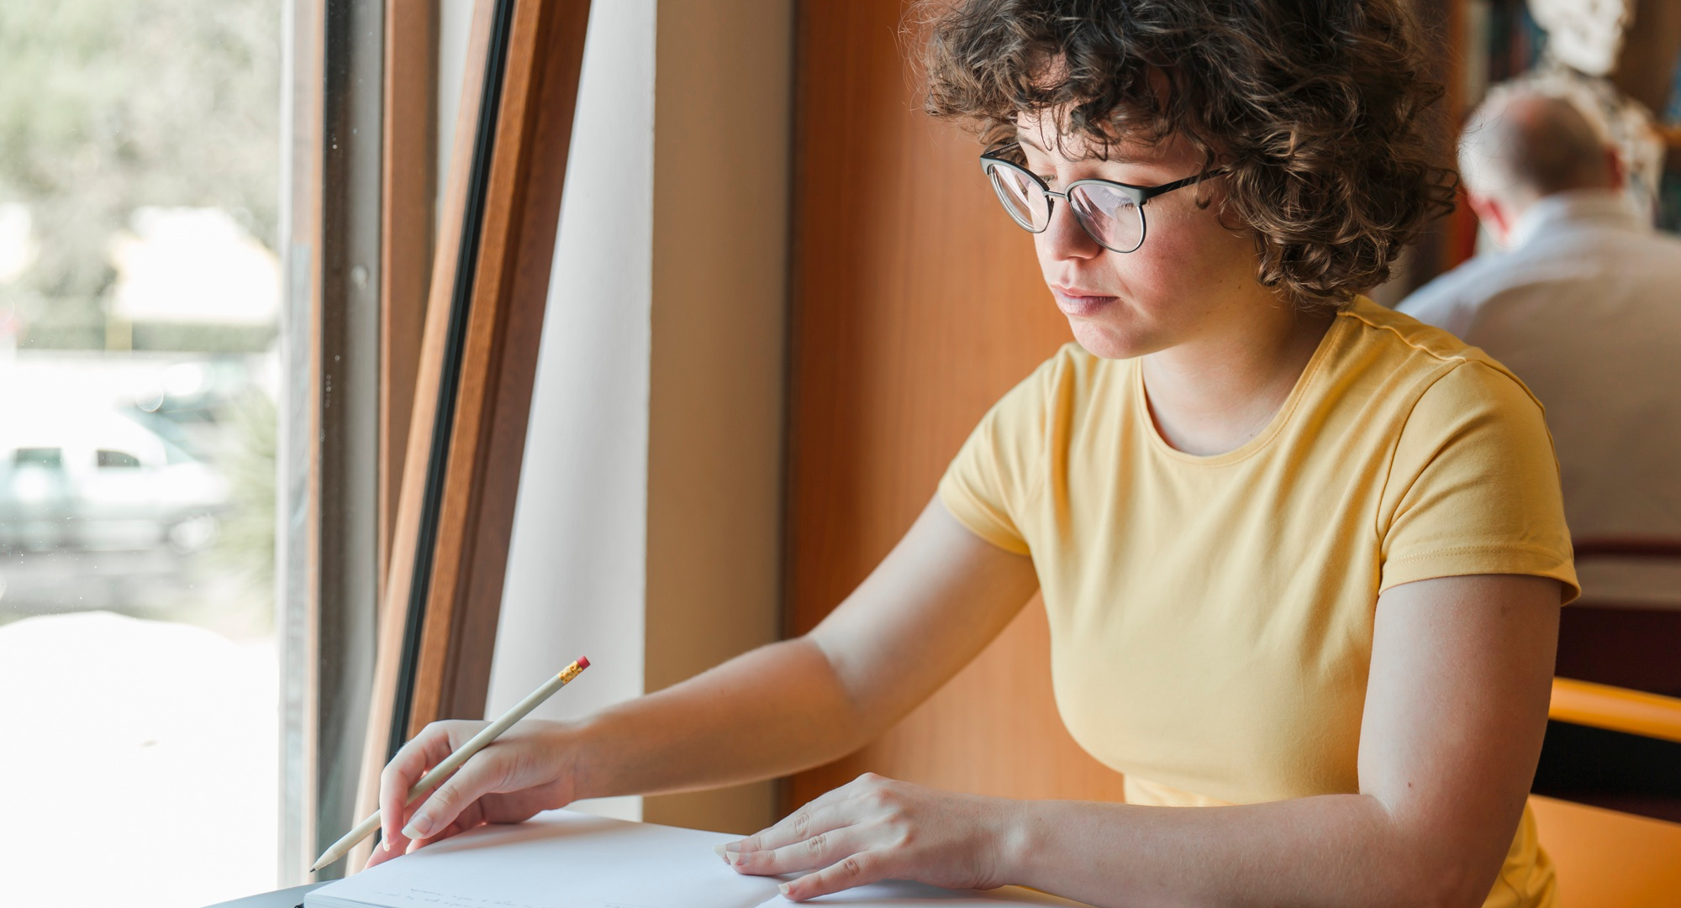
A picture is worth a thousand words

Slide 14

A picture always reinforces the concept
Images reveal large amounts of data, so remember: use an image instead of a long text. Your audience will appreciate it

Slide 15
Our values
Mars
Neptune
Despite being red, Mars is actually a cold place
Neptune is very far from the Sun
Jupiter
Saturn
Jupiter is the biggest planet of them all
Saturn is a gas giant and has several rings

Slide 16

Let's see examples
You can replace the image on the screen with your own work. Just right-click on it and select “Replace image”

Slide 17
Our success
25%
50%
75%
Mercury
Venus
Mars
Mercury is the closest planet to the Sun and the smallest of them all
Venus has a beautiful name and is the second planet from the Sun
Despite being red, Mars is actually a cold place. It’s full of iron oxide dust

Slide 18
Creative writing around the world
Mercury
Mercury is the closest planet to the Sun and the smallest one
Venus
Venus has a beautiful name and is the second planet from the Sun

Slide 19
9h 55m 23s
333,000
386,000 km
Jupiter's rotation period
The Sun’s mass compared to Earth’s
Distance between Earth and the Moon

Slide 20
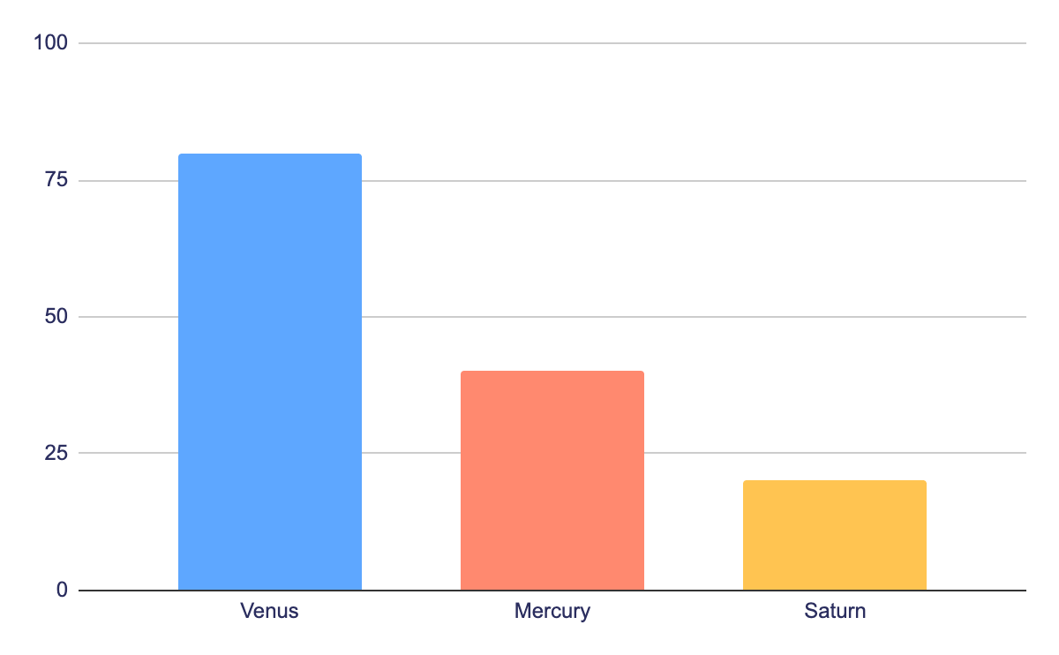
Statistics
80%
Venus
40%
Mercury
20%
Venus is the second planet from the Sun
It’s the closest planet to the Sun
Saturn
It’s composed of hydrogen and helium
Follow the link in the graph to modify its data and then paste the new one here. For more info, click here

Slide 21
Our teachers
Sofia Hill
Jim Harris
You can speak a bit about this person here
You can speak a bit about this person here

Slide 22
Our goals
Mercury
Mercury is the closest planet to the Sun and the smallest of them all
Venus
Venus has a beautiful name and is the second planet from the Sun
Mars
Despite being red, Mars is actually a cold place. It’s full of iron oxide dust

Slide 23
Monthly competitions
Venus
Mercury
Month
Mo | Tu | We | Th | Fr | Sa | Su
 | 1 | 2 | 3 | 4 | 5 | 6
7 | 8 | 9 | 10 | 11 | 12 | 13
14 | 15 | 16 | 17 | 18 | 19 | 20
21 | 22 | 23 | 24 | 25 | 26 | 27
28 | 29 | 30 | 31
Venus is the second planet from the Sun
It’s the closest planet to the Sun
Saturn
It’s composed of hydrogen and helium

Slide 24
Student progress
1ST term
2ND term
3RD term
4TH term
Saturn
Mercury
Mars
Venus
Saturn is a gas giant and has several rings
Mercury is the closest planet to the Sun
Despite being red, it’s actually a cold place
Venus is the second planet from the Sun

Slide 25
Enrollment process
Despite being red, Mars is actually a cold place
01
02
Venus is the second planet from the Sun
Jupiter is the biggest planet in the Solar System
03
04
Saturn is composed of hydrogen and helium
Neptune is the farthest planet from the Sun
05

Slide 26
Special reminders
Do you know what helps you make your point clear?
Lists like this one:
They’re simple
You can organize your ideas clearly
You’ll never forget to buy milk!
And the most important thing: the audience won’t miss the point of your presentation

Slide 27
Thanks!
Do you have any questions?
youremail@freepik.com
+34 654 321 432
yourwebsite.com
Please keep this slide for attribution

